Slide 1
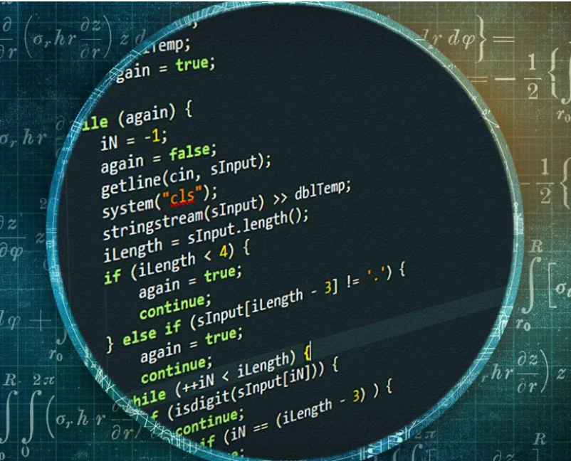
ALOGRITHM TECHINQUES
Notes:
NOTE:
To change the image on this slide, select the picture and delete it. Then click the Pictures icon in the placeholder to insert your own image.

Slide 2
CONTENT:
What is an Algorithm.
Algorithm Design Techniques.
Brute Force Approach.
Divide And Conquer Approach.
Greedy Approach.
Dynamic Programming.

Slide 3
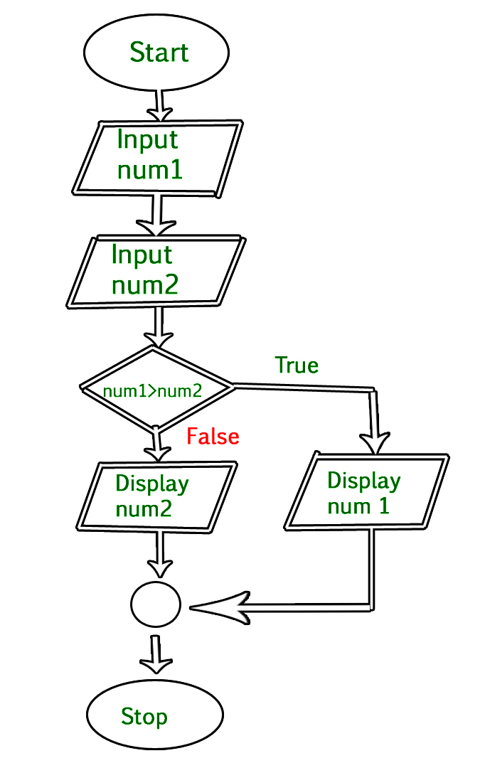
What is an Algorithm:
An algorithm is a set of clear, step-by-step instructions designed to perform a specific task or solve a problem.
Figure 1: Algorithm

Slide 4
Algorithm Design Techniques:
Algorithm design techniques are methods used to create effective and efficient algorithms to solve specific problems.

Slide 5
Brute Force Approach:
The Brute Force Approach is a method where you try all possible solutions to a problem to find the best one, without using any shortcuts or optimizations.

Slide 6
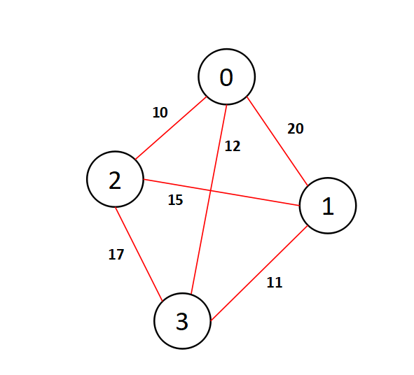
How Brute Force Approach Works?
Generate All Possibilities: List out every potential solution.
Evaluate Each Option: Check each one to see if it solves the problem or meets the criteria.
Select the Best: Choose the solution that performs the best or meets the goal.
Figure :02 Brute Force Approach

Slide 7
Divide And Conquer Approach:
The Divide and Conquer approach is a method of solving complex problems by breaking them down into smaller, more manageable parts, solving each part independently, and then combining the solutions.

Slide 8
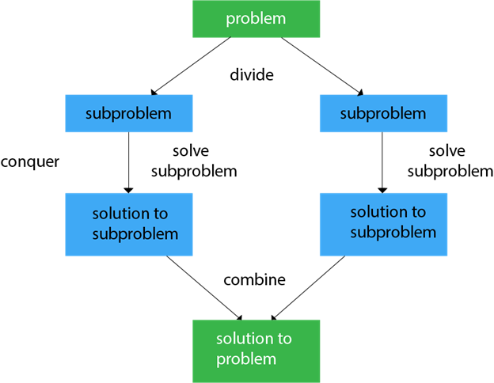
How Divide And Conquer Approach?
Divide: Break the main problem into smaller, simpler subproblems that are easier to solve.
Conquer: Solve each of these subproblems individually, often using the same strategy or method.
Combine: Merge the solutions of the subproblems to form the solution to the original, larger problem.
Figure : 03 Divide and Conquer

Slide 9
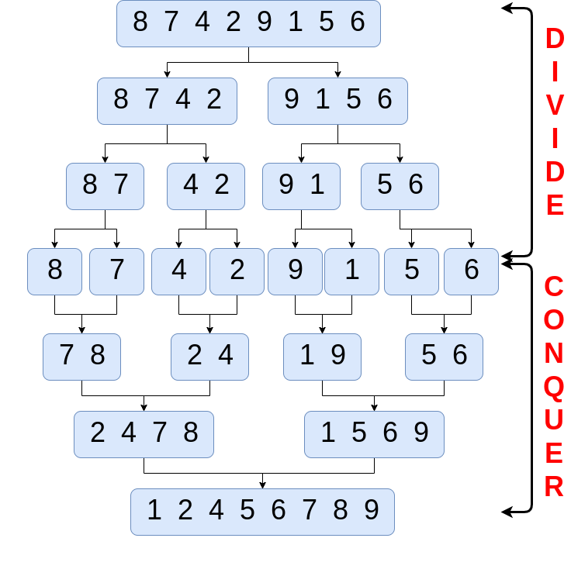
EXAMPLE:
STEP :1
STEP :2
STEP :3
STEP :4
STEP : 5
STEP :6
Figure : 04
Divide and Conquer

Slide 10
Greedy Approach:
The Greedy Approach is a method where you make the best possible choice at each step, hoping that these local optimal choices will lead to a globally optimal solution.

Slide 11
How Greedy Approach Works?
Start with the Initial Step: Begin with the first step of the problem.
Make the Best Choice: At each step, choose the option that seems the best at that moment (the "greedy" choice).
Move to the Next Step: After making a choice, move to the next step and repeat the process.
Reach a Solution: Continue this process until you reach a solution, without reconsidering previous choices.

Slide 12
Advantages , Disadvantages And Uses Of Greedy Approach:
Advantages: Greedy algorithms are straightforward and usually run quickly due to their simple approach.
Disadvantages: They might not find the optimal solution for every problem since they don’t consider future consequences of choices.
Uses: Suitable for problems where making a series of local optimal choices leads to a globally optimal solution, such as in scheduling and certain optimization problems.

Slide 13
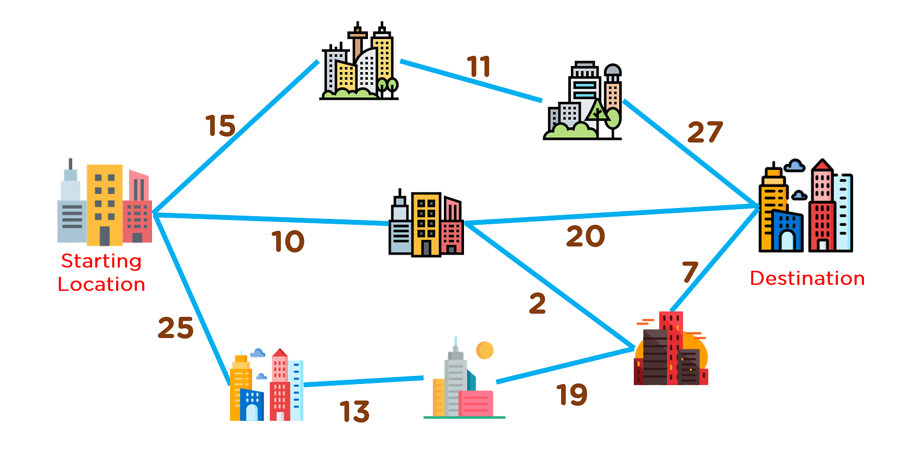
EXAMPLE:
Figure : 05 Greedy Approach

Slide 14
Dynamic Programming Approach:
Dynamic programming is a problem-solving technique that breaks down a complex problem into simpler subproblems and solves each subproblem only once, storing their solutions. It uses these stored solutions to build up the solution to the overall problem, avoiding redundant work.

Slide 15
How Dynamic Programming Works?
Break Down the Problem: Divide the main problem into smaller, overlapping subproblems.
Solve Subproblems: Solve each subproblem independently.
Store Solutions: Save the results of subproblems in a table (memorization) or build a solution iteratively (tabulation) to avoid redundant calculations.
Build the Final Solution: Use the stored solutions to construct the solution to the overall problem.
By solving and storing solutions to overlapping subproblems, dynamic programming ensures efficient computation and avoids unnecessary repetition.

Slide 16
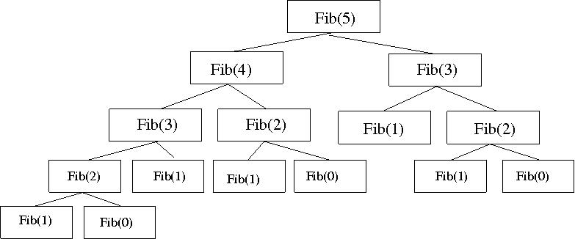
EXAMPLE:
The Fibonacci series is a sequence of numbers where each number after the first two is the sum of the two preceding ones.
F(n)=F(n−1)+F(n−2)
Figure : 06 Dynamic Programming approach

Slide 17
Divide And Conquer Approach Vs Dynamic Programming :
Divide and Conquer: Breaks a problem into separate, independent parts, solves each part separately, and then combines the solutions. Think of it as splitting a problem into chunks, solving each chunk, and putting the pieces together.
Dynamic Programming: Breaks a problem into overlapping parts, solves each part once, and stores the results so you don’t have to solve the same part multiple times. Think of it as solving a problem by remembering solutions to smaller pieces and building up from there

Slide 18
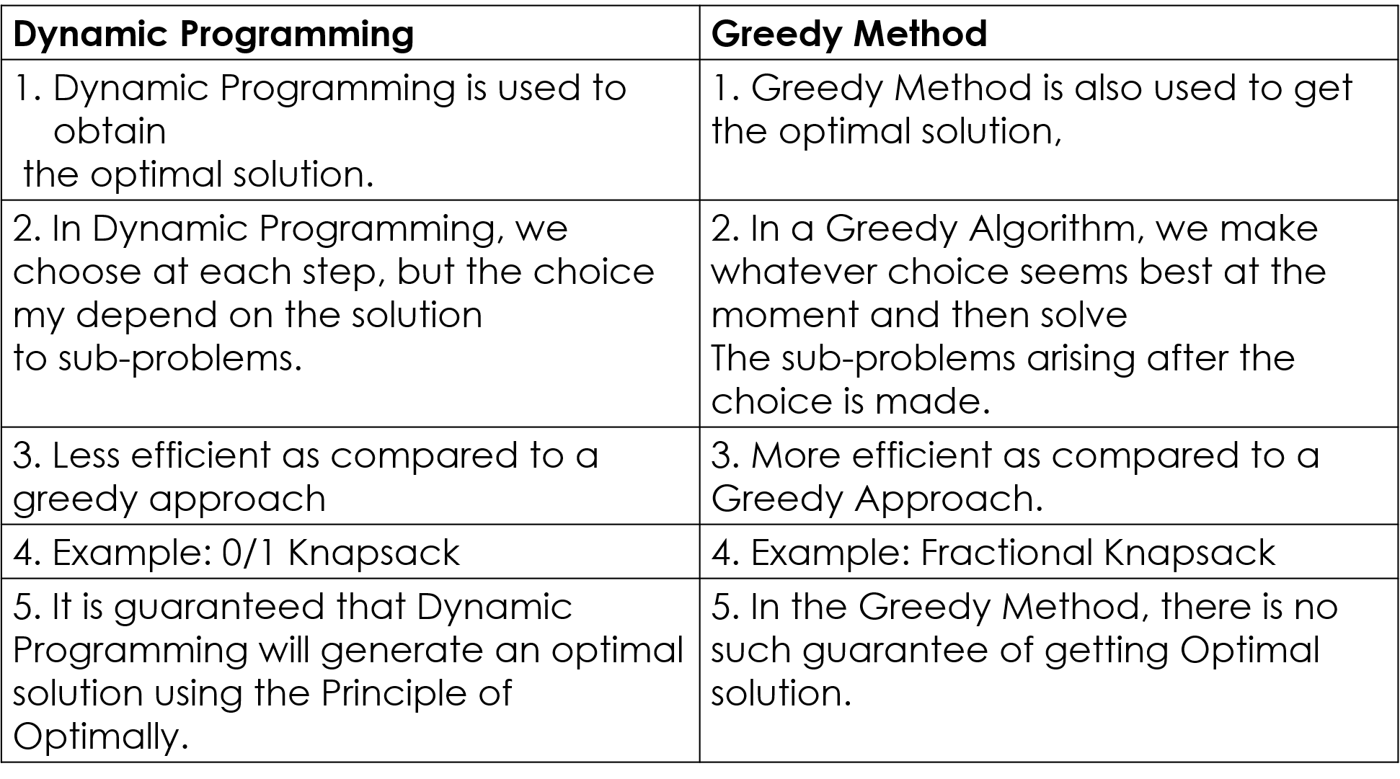
Difference btw Dynamic Programming vs Greedy Method

Slide 19
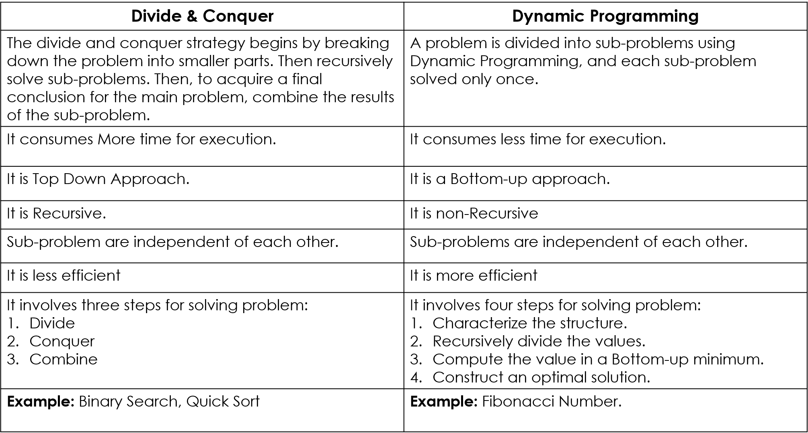
Difference btw Divide & Conquer vs Dynamic Programming
8
Image no 4: Shows Difference btw D&C vs DP

Slide 20
THANK YOU

